Slide 1
IT290 SEMINAR
Face Recognition With OpenCV
BY
Madhava Chary Ravula(201IT235)
Shivam Revansiddh Khose(201IT257)

Slide 2
LITERATURE SURVEY
Facial Recognition using OpenCV by Shervin Emami and Valentin Petrut
The paper relies on analysis in face recognition
Provides readers with an additional study understanding of face recognition ways & applications
The face recognition system directly compares the face photos of individuals and does not use ID numbers to differentiate one from the others
Once the very best two matched faces are extremely just like the query face image,
then manual review is needed

Slide 3
PROBLEM STATEMENT ?
Given still or video images of a scene, identify or verify one or more persons in the scene using a stored database of faces

Slide 4
INTRODUCTION
Face detection and recognition have transcended from esoteric to popular areas of research in computer vision.
One of the better and successful applications of image analysis and algorithm based understanding
With the help of such a technology one can easily detect the face by the help of dataset in similar matching appearance of a person

Slide 5
Facial recognition generally involves two stages
Face Detection
Photo is searched to find a face, then the image is processed to crop and extract the person’s face for easier recognition
Face Recognition
Where that detected and processed face is compared to a database of known faces, to decide who that person is

Slide 6
Methodology
OpenCV
Image processing and performing computer vision tasks
Open-source library that can be used to perform tasks like face detection, objection tracking, landmark detection
Supports multiple languages including python, java C++
With less system RAM, OpenCV works better

Slide 7
Methodology…
Dlib
Implementation of ‘deep metric learning’ which is used to construct our face embeddings used for the actual recognition process
Originally written in C++, it has good, easy to use Python bindings
Major use of dlib for face detection and facial landmark detection

Slide 8
Methodology…
face_recognition
Find all the faces that appear in a picture
Locate the facial features of a person in an image
Built using the dlib library, which is built using C++ Language

Slide 9
Implementation
Loading Images
Finding faces in the image
Comparing and finding distance between faces

Slide 10
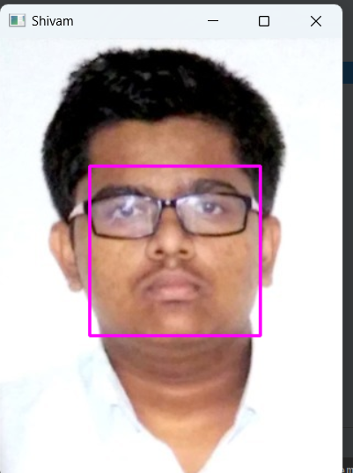
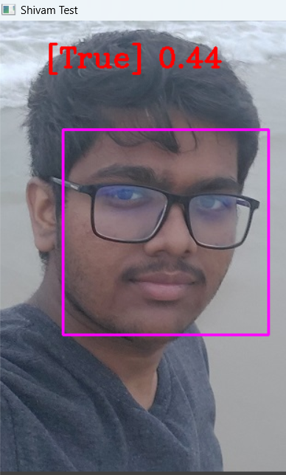
Result

Slide 11
Future Scope
Can be used in many industry fields for betterment
Many useful applications like attendance , security purpose by face recognition in real world
Obtain consistency in classification of images and emotions on the face

Slide 12
Conclusion
We achieved our goal to detect and recognize the faces within the frame with accuracy
Able to find encodings and face distance between the images
We are able to recognize and store the information of persons within the frame

